Slide 1




AI VIDEO AND AUDIO ENHANCEMENT

Slide 2

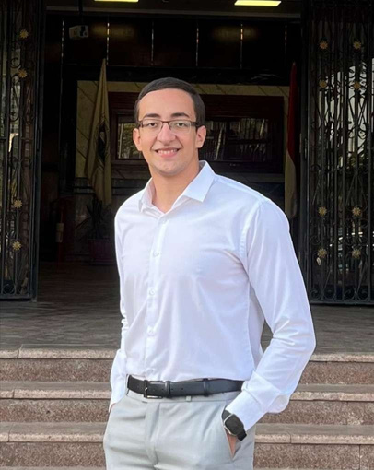
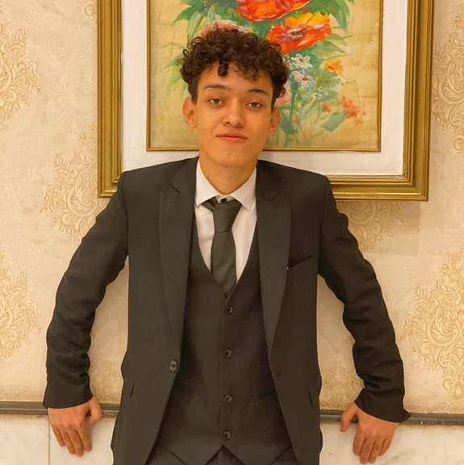



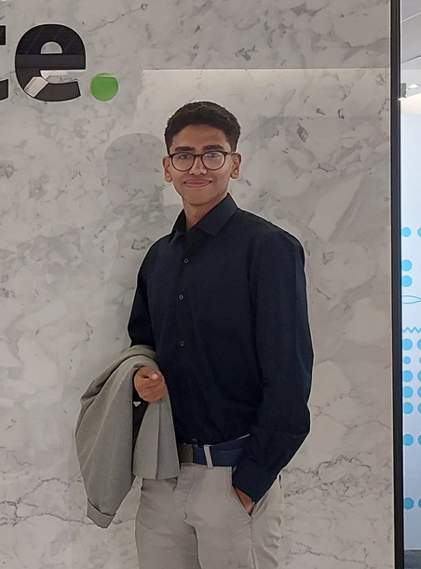


TEAM MEMBERS
Mohamed Ahmed
Seif Ahmed
Abdallah Ashraf
Abdelrahman Emad
Nour Eldin Mohamed
Seif Aldien Ahmed

Slide 3
SUPERVISORS
Dr. Sally Saad
TA. Mohammad Essam
Department : Computer Science

Slide 4

Content
01
Introduction
Problem Definition & Motivation
Objectives
System Architecture
Model Architecture
Description of Dataset
Experiments & Results
Demo
Conclusion
Future Work
02
03
04
05
06
07
08
09
10

Slide 5

Introduction
The shift to online education has made video lectures a crucial part of modern learning,
In today's digital world, high-quality audio and video are essential for communication, content creation, and entertainment. However, many recordings suffer from background noise and low resolution.
This project aims to solve this problem using AI. We developed a system that enhances video and audio quality using deep learning models. By removing noise, sharpening visuals, and improving overall clarity.heir effectiveness.

Slide 6
Problem definition
01
The shift to online education has made video lectures a crucial part of modern learning,
Many educational videos have issues like low resolution and poor audio, impacting their effectiveness.
02
03
Most tools overlook enhancing pre-recorded educational lectures.
The proposed project, AI Video and Audio Enhancement, uses AI technology to automatically enhance video quality and audio clarity.
04
05
This ensures that students receive high-quality, clear instructional videos, enhancing their learning experience.

Slide 7

Motivation
We conducted a survey that received 260 responses, indicating a growing demand for high-quality video content across various sectors. The key findings include:
User preferences for video quality
Common video quality issues
Impact of poor audio quality
Market demand for enhancement solutions
The need for high-resolution content and clear audio in professional and personal content.

Slide 8
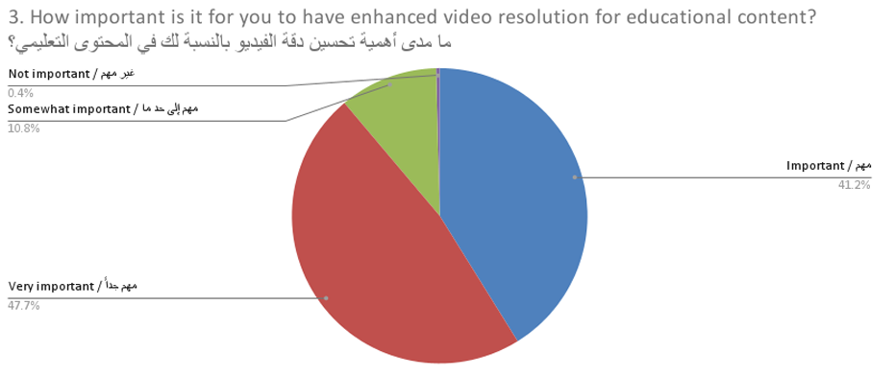
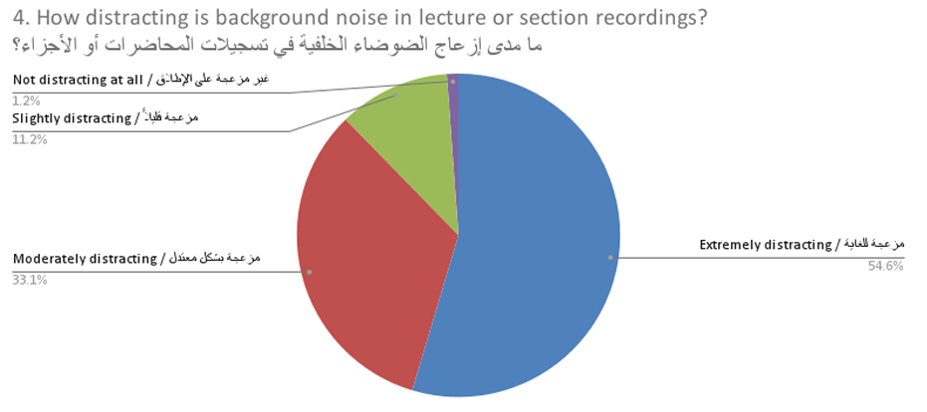
Motivation

Slide 9
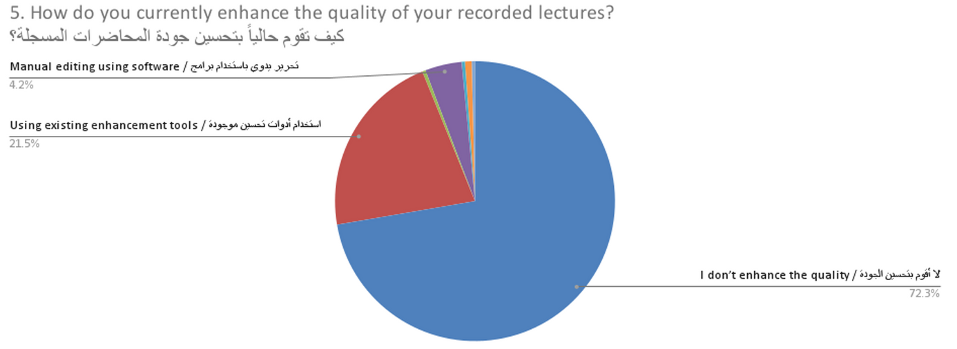
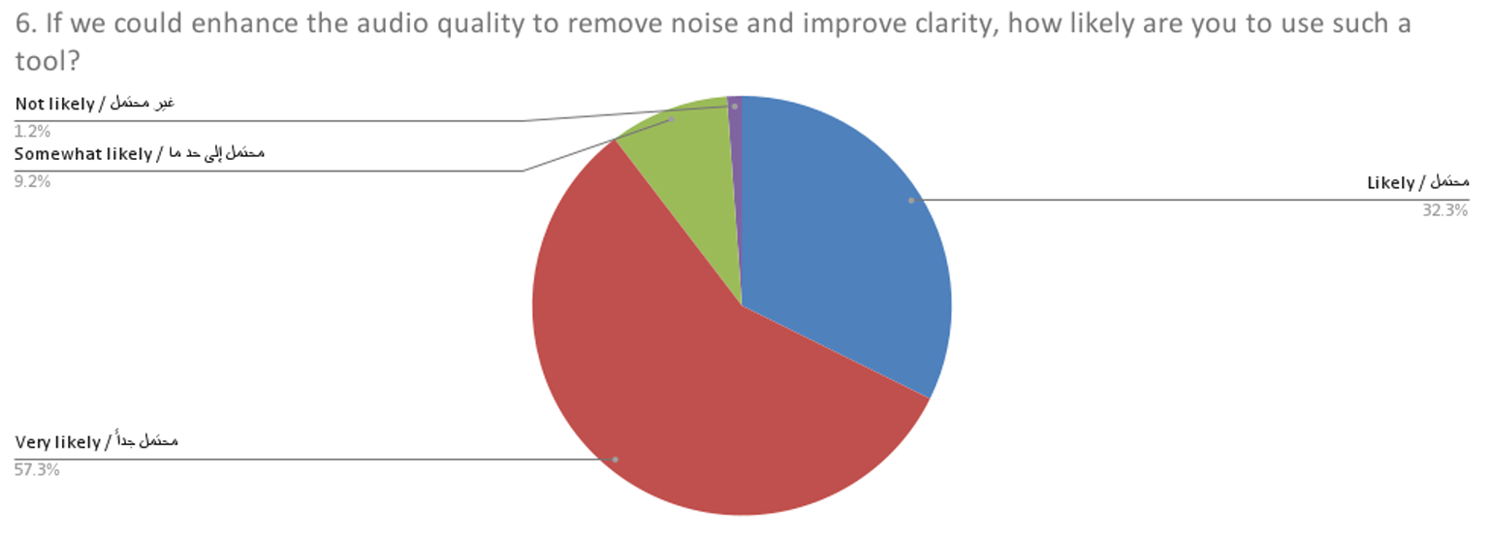
Motivation

Slide 10
Objectives
Design and implement a user-friendly interface for video processing and enhancement for the website.
Build an AI-powered video upscaling feature to improve video resolution while retaining critical details.
Implement an intelligent audio noise reduction system that removes unwanted background noise while maintaining voice clarity.

Slide 11
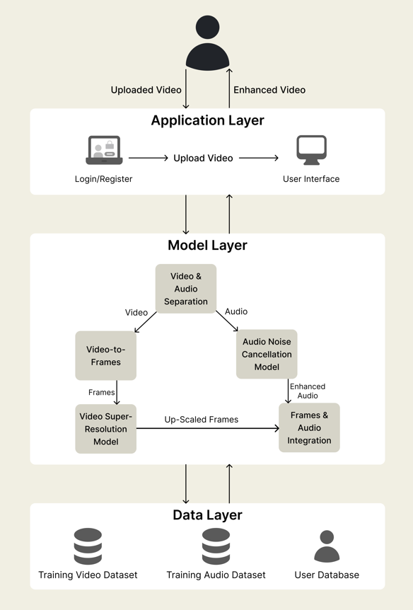
System Architecture

Slide 12


Model Architecture

Slide 13
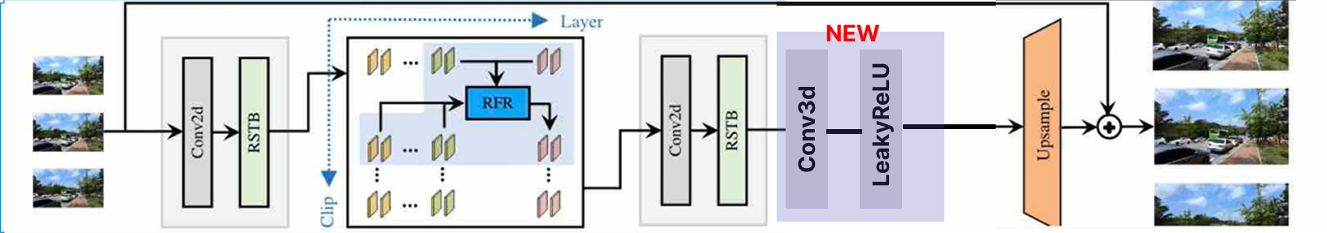
Model Architecture
Video Model (RVRT)
RVRT chops the video into small overlapping clips, processes each clip with the same Transformer block.
Low Memory Use: By sharing the same Transformer weights on each clip and only keeping one clip’s activations in memory at a time.
Long‑Range Dependency: by passing learned features forward clip by clip.
Inserts a residual block (3× Conv3d + LeakyReLU) immediately before upsampling.

Slide 14
Model Architecture
Video Model (RVRT)
Decrease the GPU usage to the half by decrease the tile
The “tile” size tells the computer to chop photo into smaller squares (tiles) and work on one square at a time.
get a higher SSIM and PSNR cause of the residual block
train on REDS dataset and test on Vid4

Slide 15
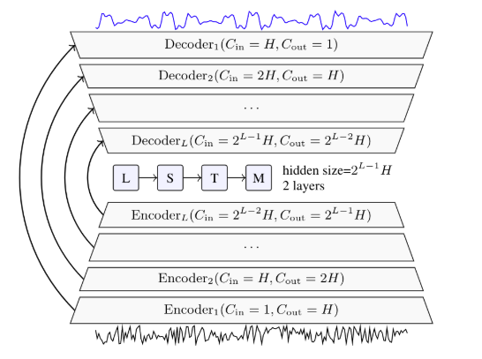
Model Architecture
Audio Model (Demucs)
Encoder blocks (E1–E4): 1D Conv layers and downsampling
Bottleneck: Bidirectional LSTM processing the compressed feature map
Fine tuning using another Dataset

Slide 16

DESCRIPTION OF DATASETS

Slide 17

Datasets
Video Super-Resolution Datasets
Dataset | Size | Resolution | Usage
REDS | 300 videos (30,000 frames) | high 1280 × 720 Low 320 x 180 | Training (40%) & Testing(100%)
Vid4 | 4 videos (~200 frames) | 720 × 480 | Testing

Slide 18
Datasets
Audio Noise Cancellation Datasets
Dataset | Properties Size (Clean/Noisy) | Sample rate
Valentini-noise | Training (56 spk): 6.7 GB / 7.8 GB Testing (2 spk): 147 MB / 162 MB | 16-44 kHz
VoiceBank+ DEMAND | Training (28 spk): 2.3 GB / 2.6 GB Testing (2 spk): 158 MB / 172 MB | 48 kHz

Slide 19
EXPERIMENTS & RESULTS

Slide 20
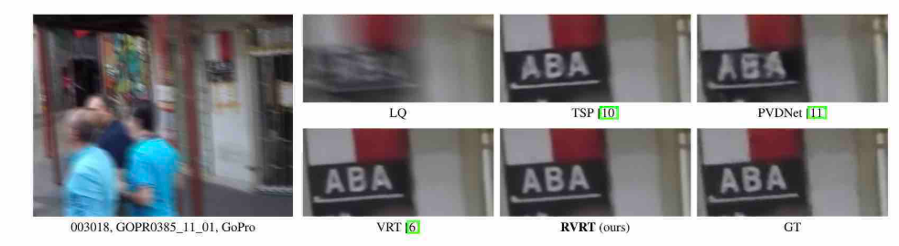
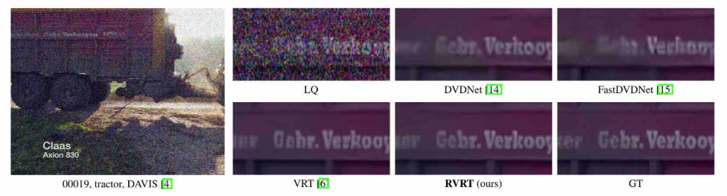
Experiments

Slide 21
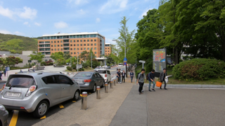
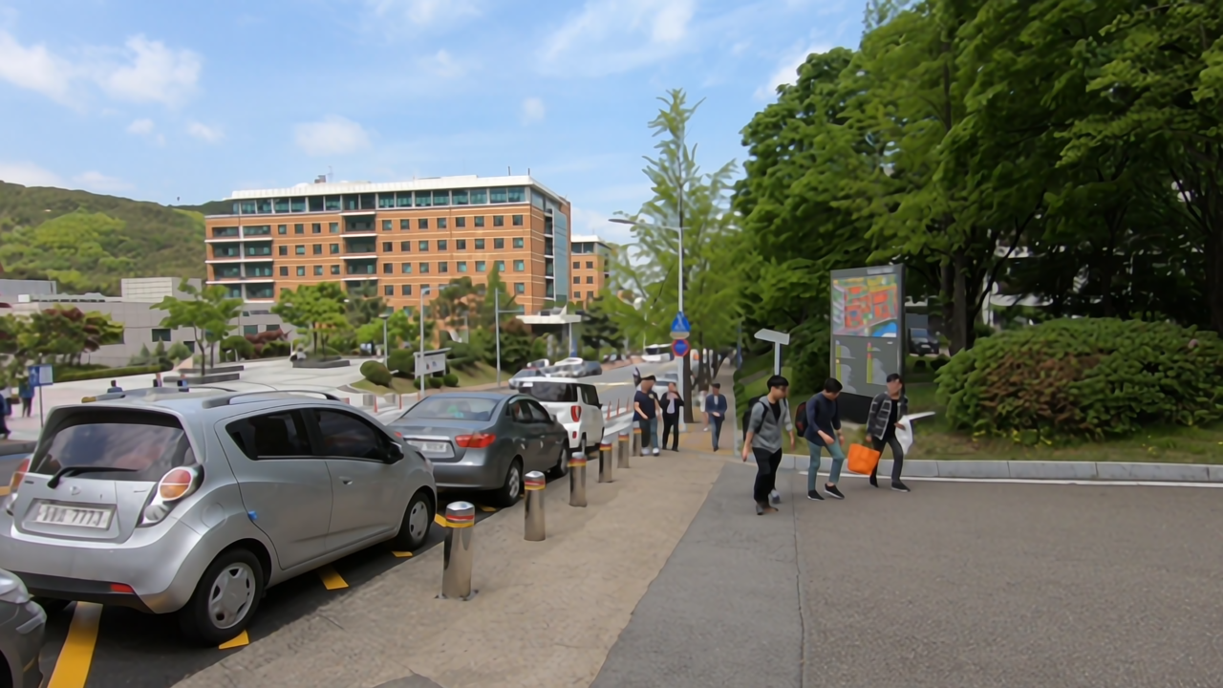
Experiments
Before
After

Slide 22
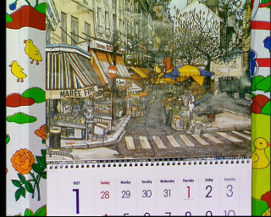
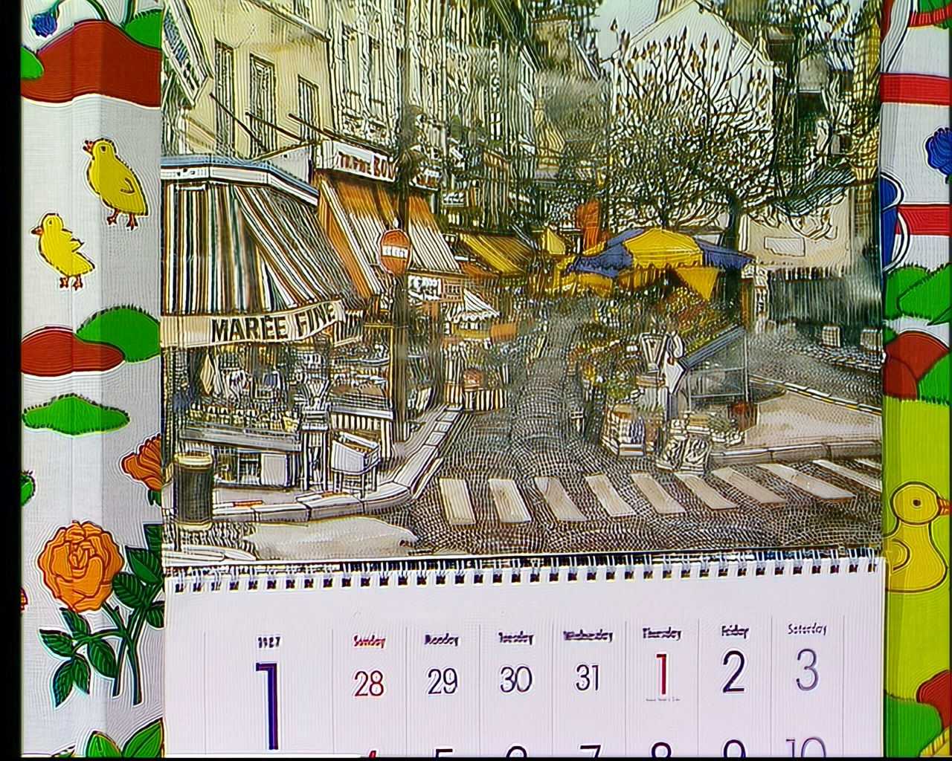
Experiments
Before
After

Slide 23
Experiments
Before
After

Slide 24
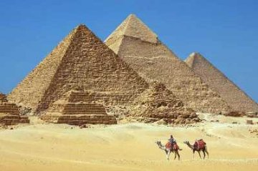

Experiments
Before
After

Slide 25
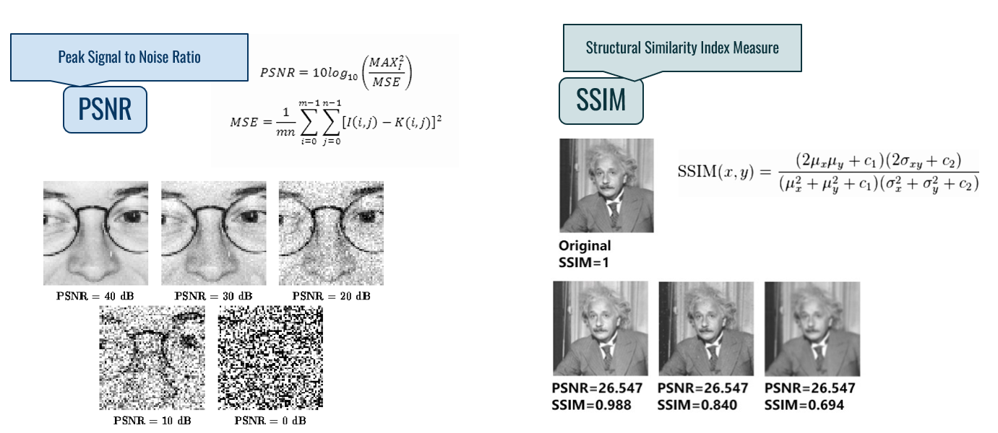
Evaluation Metrics

Slide 26
Results
Our Video Model vs. Baseline
Architecture | Avg. PSNR (dB) | SSIM | PSNR_Y (dB) | SSIM_Y
Our Model | 31.76 | 0.8881 | 33.14 | 0.9006
Baseline | 29.91 | 0.8398 | 31.26 | 0.8562

Slide 27


Results
Audio Before

Slide 28
Results
Audio After

Slide 29
Results
Our Audio Model
Dataset | PESQ | Usage
Valentini-noise | 3.15 | Training & Testing (100%)
VoiceBank+ DEMAND | 2.91 | Training & Testing (100%)

Slide 30
DEMO

Slide 31
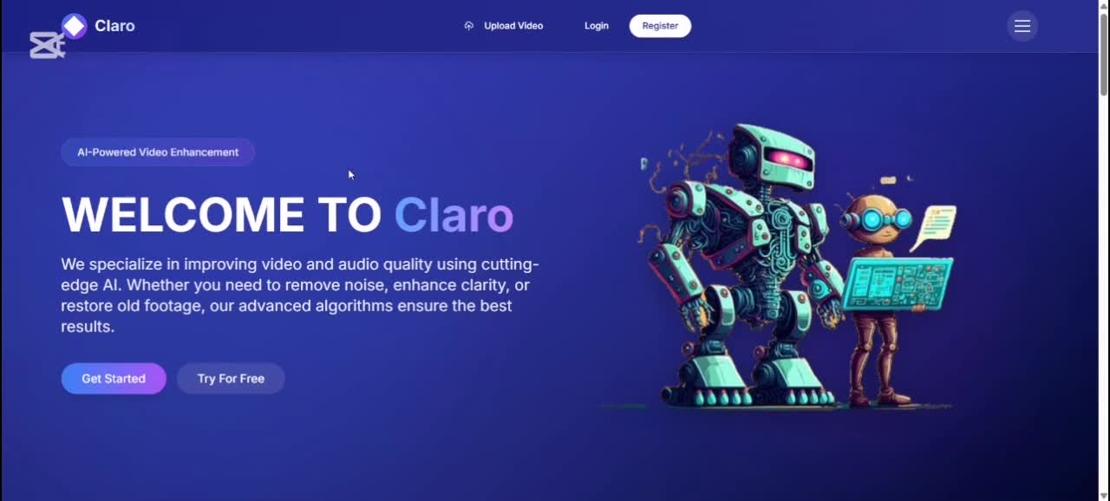

Slide 32

Before

Slide 33
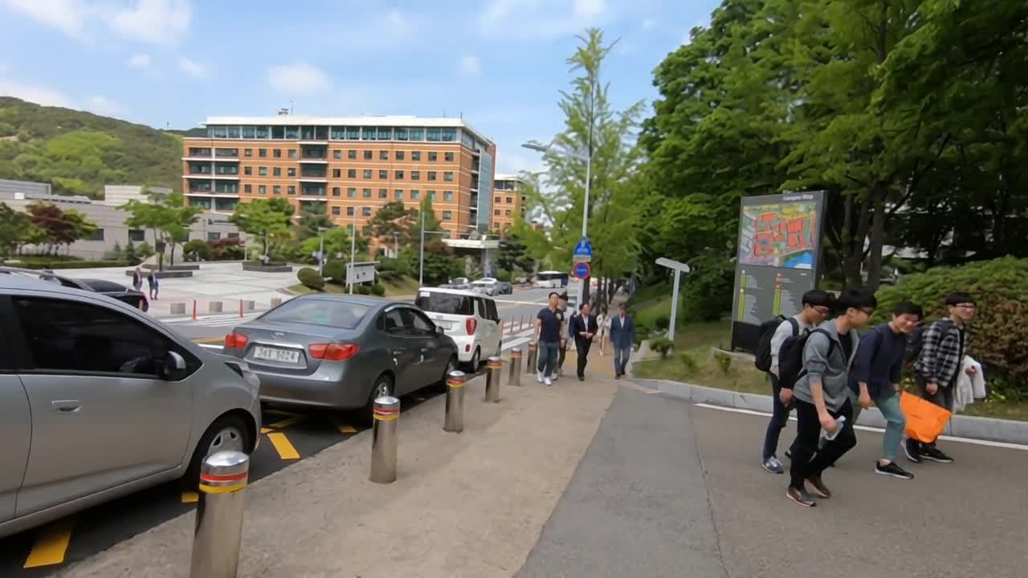
After

Slide 34
Conclusion &
Future Work

Slide 35

Conclusion
In this project, we successfully implemented AI-based techniques to enhance the quality of both video and audio content.
By leveraging advanced deep learning models, we were able to reduce background noise, sharpen blurry visuals, and improve the overall clarity of media files.
The results demonstrate the potential of AI in restoring low-quality recordings and making them more suitable for professional and personal use.

Slide 36

Future Work
Real-time Processing: Extend the system to support real-time video and audio enhancement for live streams or calls.
Mobile Integration: Build lightweight versions of the models to run on mobile devices with limited resources.

Slide 37

References
J. Liang, Y. Fan, X. Xiang, R. Ranjan, E. Ilg, S. Green, and R. Timofte, "Recurrent Video Restoration Transformer with Guided Deformable Attention," Advances in Neural Information Processing Systems, vol. 35, pp. 378–393, 2022. [Online]. Available: https://arxiv.org/pdf/2206.02146
[1]
[2]
J. Liang, J. Cao, Y. Fan, R. Ranjan, K. Zhang, Y. Li, R. Timofte, and L. Van Gool, "VRT: A Video Restoration Transformer," arXiv preprint arXiv:2201.00001, Jan. 2022. [Online]. Available: https://arxiv.org/pdf/2201.12288v2
[3]
X. Wang, Y. Xie, and C. Dong, "Real-ESRGAN: Training Real-World Blind Super-Resolution With Pure Synthetic Data," arXiv preprint arXiv:2107.10833, Jul. 2021. [Online]. Available: https://arxiv.org/pdf/2107.10833

Slide 38
References
[4]
M. Singh, L. Gupta, and D. Patil, "aTenuate: Adaptive Noise Cancellation for Clear Audio in Educational Content," arXiv preprint arXiv:2409.03377, Sep. 2024. [Online]. Available: https://arxiv.org/pdf/2409.03377
[5]
H. Zhao, P. Liu, and S. Chen, "DeepFilterNet: Perceptually Motivated Real-Time Speech Enhancement" arXiv preprint arXiv:2408.06264, Aug. 2024. [Online]. Available: https://arxiv.org/pdf/2408.06264
[6]
J. Valin, "RNNoise+: Enhanced Speech Denoising for Real-Time Applications," 2021. [Online]. Available: https://github.com/xiph/rnnoise

Slide 39

THANK YOU

